Slide 1

Open Innovation Test Bed for nano-enabled Membranes

Slide 2
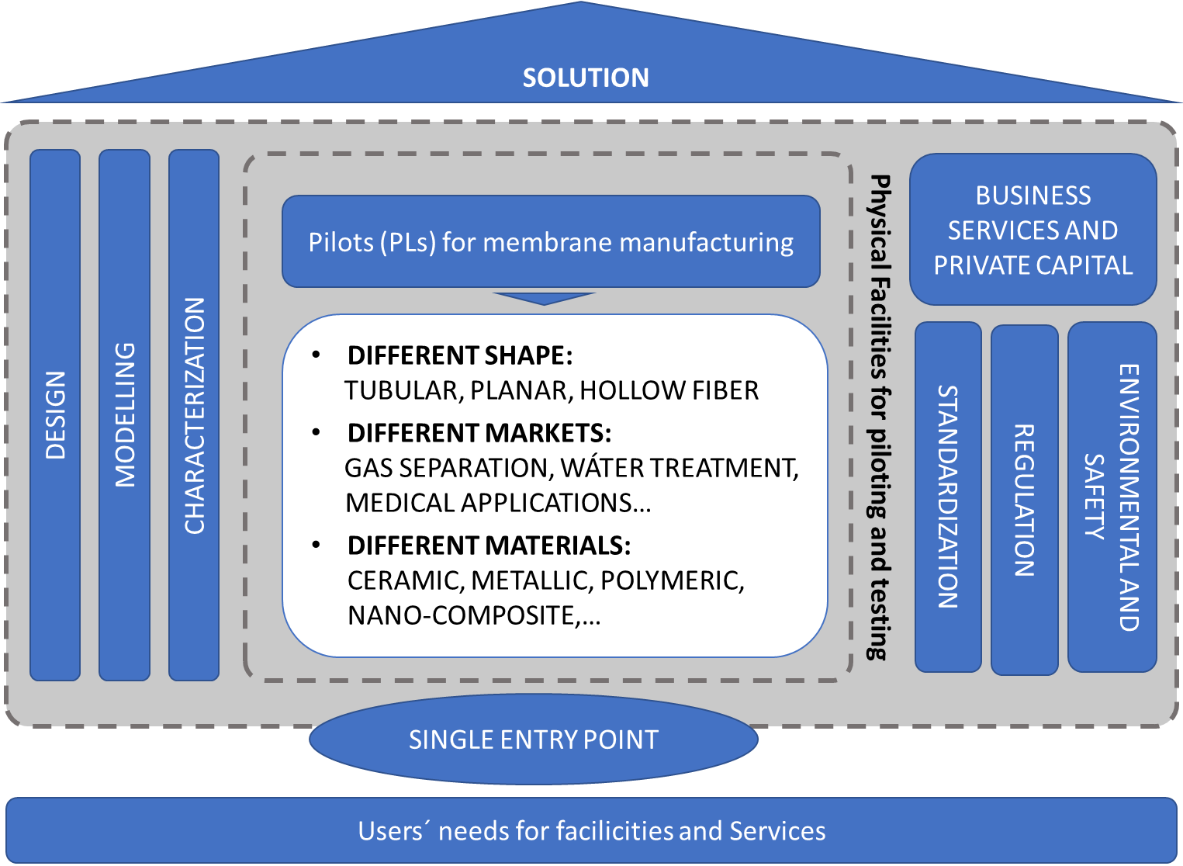
Creation of a sustainable Open Innovation Test Bed
Budget: 16 M€.
Start: May ‘20.
Duration: 4 years

Slide 3
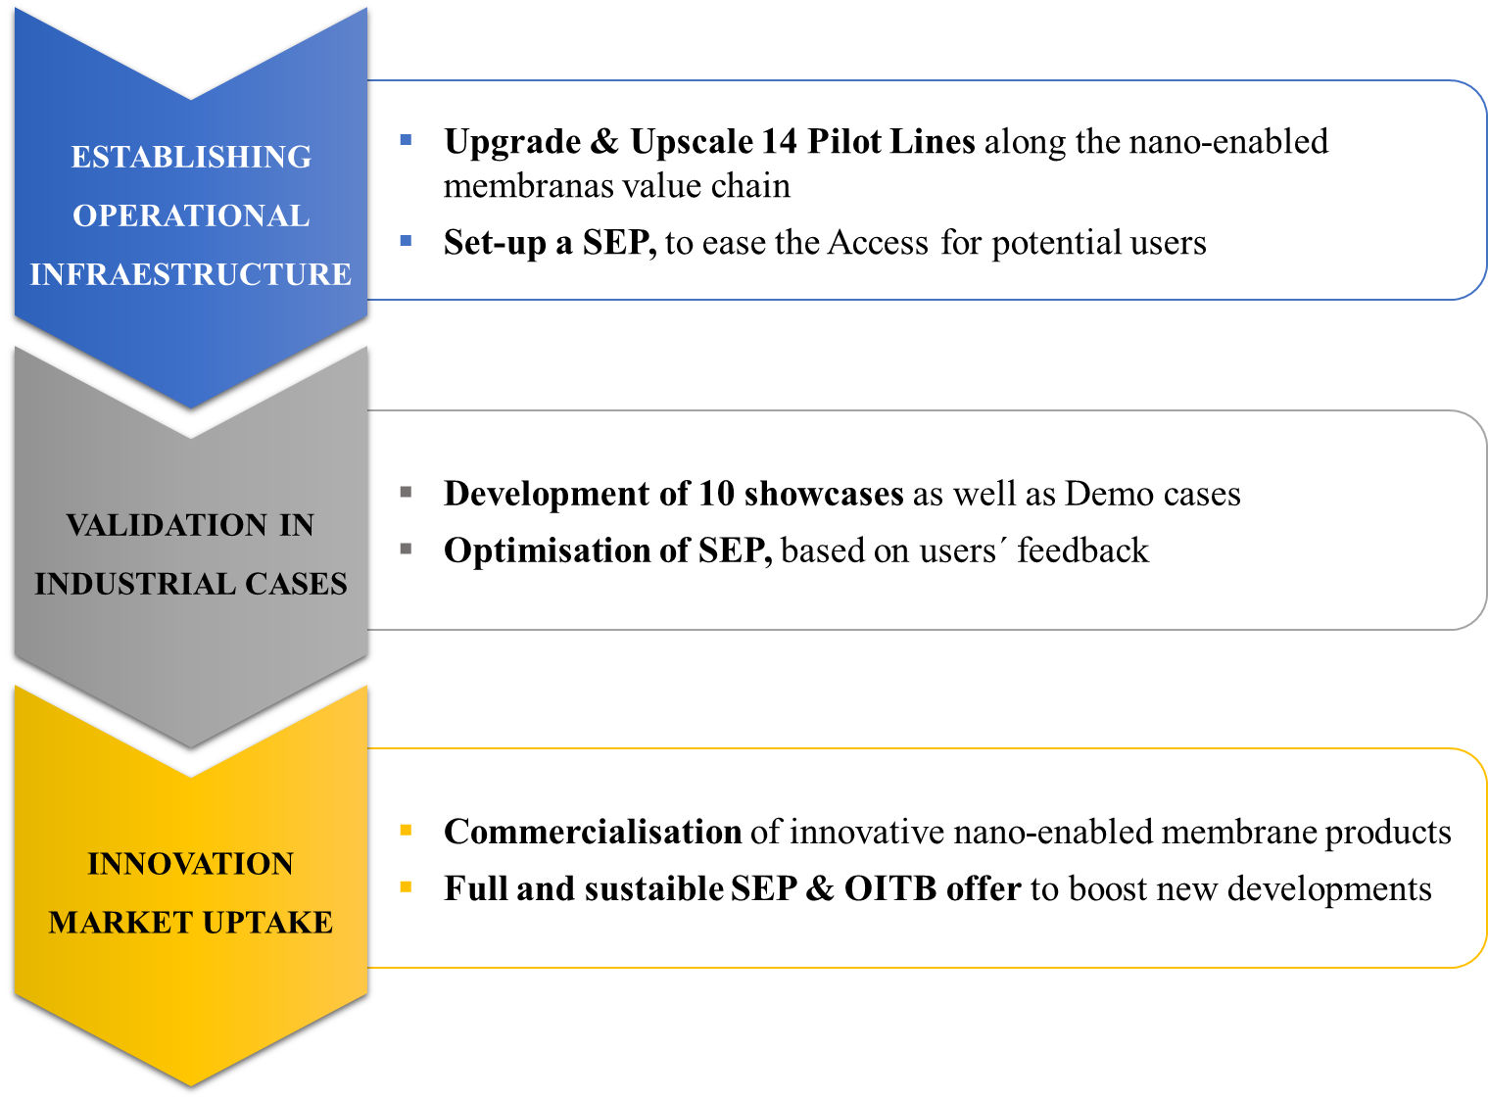
Specific objectives
Notes:
Remove July 2020

Slide 4
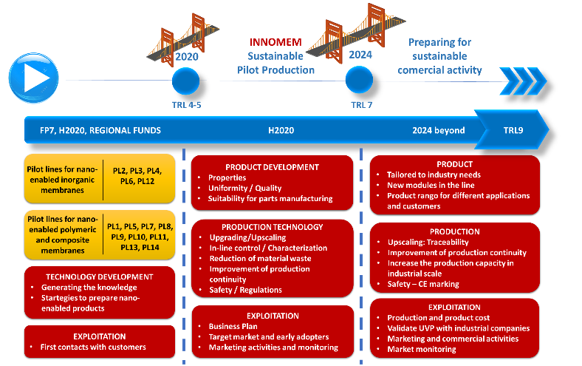
Specific objectives

Slide 5
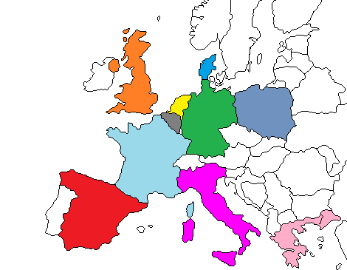
Consortium
32 partners from 10 countries.
15 UNI/RTO + 11 SME + 6 IND
INNOMEM gathers relevant expertise that will be used for:
Setup of services related to PLs by RTOs and academic partners + virtual labs for characterization (CNR) and modelling (TUE).
10 industrial showcases driven by industrial partners leaders in their sectors: LIQTECH, FILATECH, POLYMEM, DBI, HTF, EVONIK, ENGIE, NXF.
Managing and providing all standardisation support related to the project by UNE
Non-technical services through the network of investors of PNO and VNTRS (support the users in the post-development phase of the democases)
Business Innovation Coaching services by PNO
Exploitation and transfer of research results by VNTRS. VNRTS will act as the SEP defining the business model and collaboration agreements between the partners.
Advisory Board: will ensure links with SMEs, associations, regional clusters, investors and other stakeholders

Slide 6
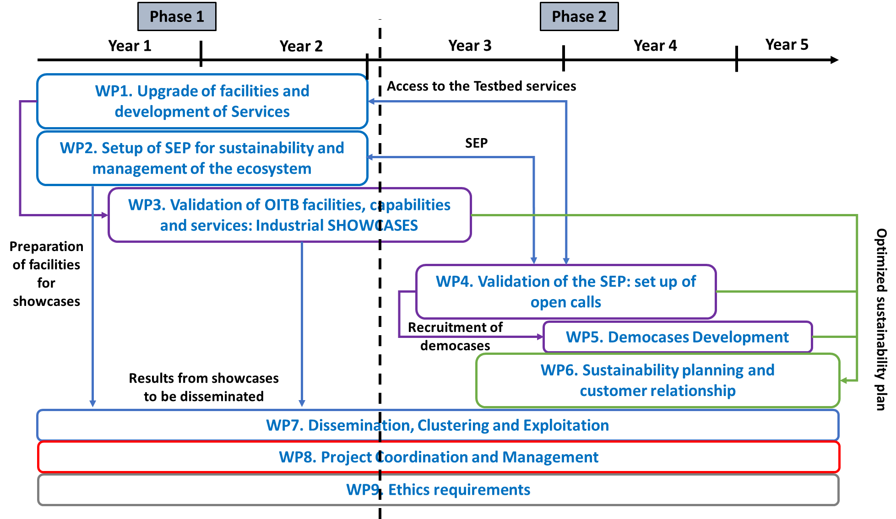
Overall approach & Methodology

Slide 7
Open Calls
- M32: December 2022
- M42: October 2023

Slide 8
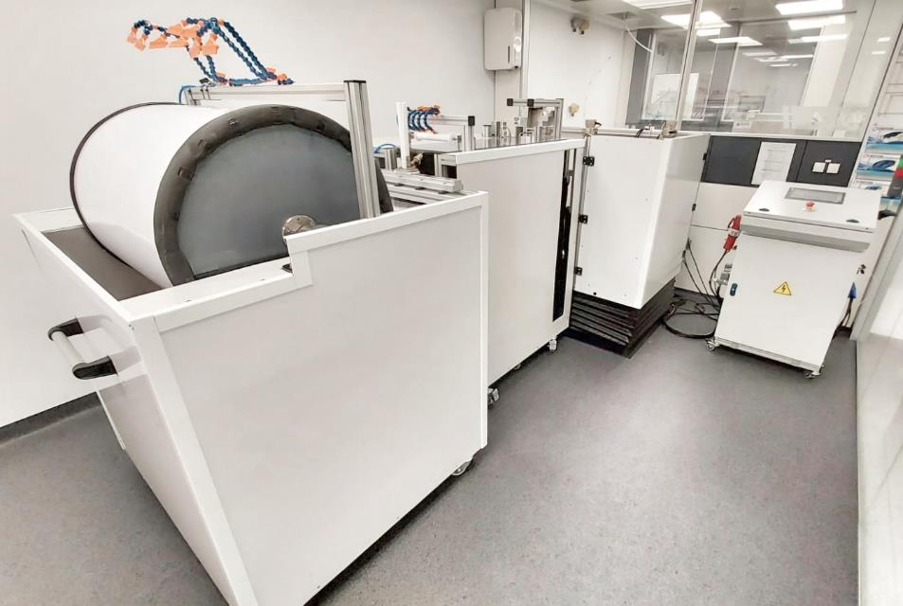

PL#1 - Dual Layer Mixed Matrix HF manufacturing system
Up-scale:
from the actual batch-wise production (200 m/batch) to continuous production with a production capacity of 7000 m/batch x 3 times (parallel production of 3 fibers in a single operation).
Up-grade:
Take up system and dope delivery system
new spinneret design
Dope delivery system and spinneret heating system
A control system to online monitored and registered all spinning parameters will be implemented.
8

Slide 9
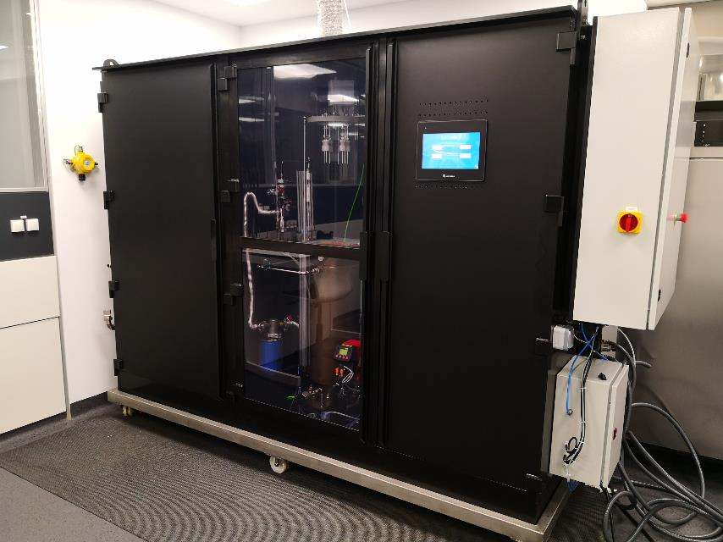

PL#2 - Pd-based membrane plating system
Up-scale:
From the actual plating preparation capacity of 4 Pd-based supported membranes per batch and
week of up to 50 cm long, to at least 16 membranes per batch and week.
Up-grade:
Automation and full-control of pre-processing steps temperature of the heating bath
solution temperature monitoring by infrared
Integration of non-destructive membrane characterization techniques

Slide 10
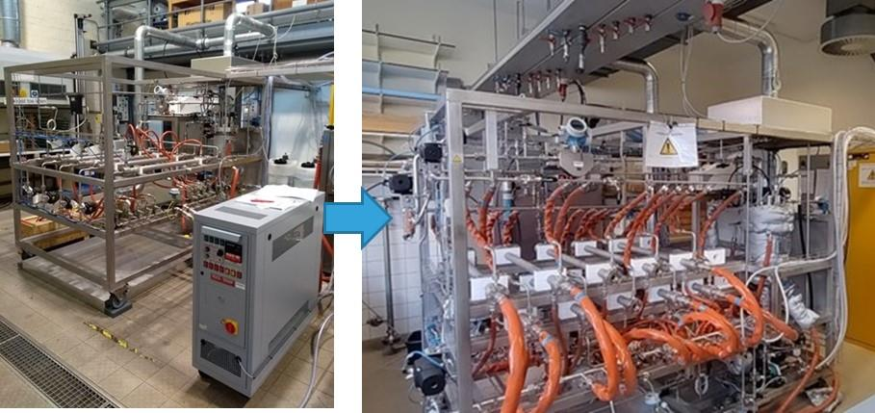

PL#3 - Grafting of ceramic membranes
Up-scale:
From grafting of 5 long multichannel elements/week to > 10 long multichannel elements/24h
Up-grade:
development of a more efficient and more sensitive quality test
in-line measurement of this parameter

Slide 11
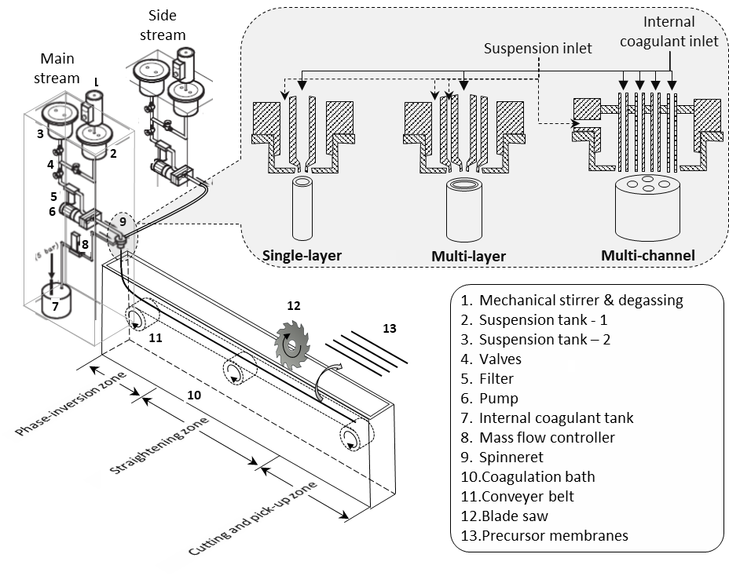


PL#4 - Pilot-line for fabricating micro-tubular ceramic membranes
This plotline would enable continuous fabrication of micro-tubular ceramic membranes with unique bi-modal pore structures. Membranes of this type can be prepared with different ceramic materials and used as :
Advanced membrane substrates for separations.
Compact and high throughput membrane units (MF & UF);
Compact and selective catalytic membrane reactor designs.

Slide 12
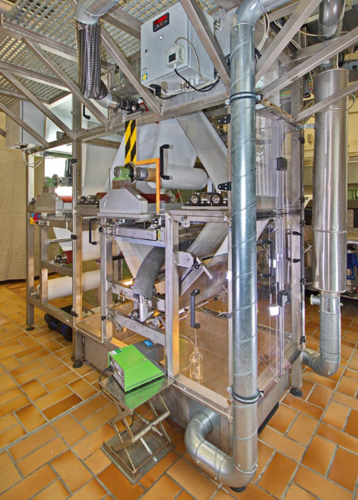
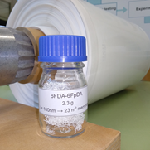
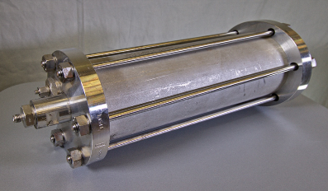


PL#5 - Flexible flat sheet polymeric membranes
Helmholtz-Zentrum Hereon – Institute of Membrane Research. Focus:
- Thin film composite membranes for gas separation
- Optimise production technology and quality control
- Production of innovative membranes for natural gas treatment: higher hydrocarbon dewpointing and CO₂/CH₄ separation.
PL 6
Tubular zeolite
membrane
Showcase 2
Zeolite and polymeric membranes in natural gas treatment
DBI Gas- und Umwelttechnik GmbH

Slide 13
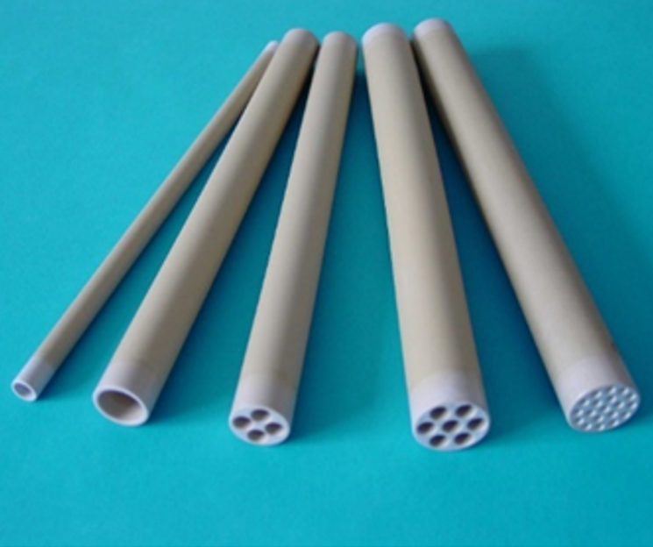

PL#6 - Zeolite membranes
Up-scale:
From the current preparation of MFI and CHA-membranes in a batch of 3 elements on tubular ceramic supports of 0.25m length to batch production of > 10 elements/batch on tubular ceramic supports of a length of 1.2 m.
Up-grade:
implementation of in-line weight and permeation control after every synthesis step
development of simplified non-destructive permporometry for in-line quality control

Slide 14
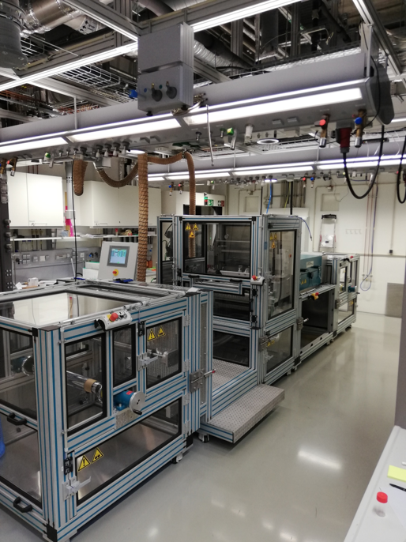

PL#7 - Roll-to-Roll Coating of Advanced Nanophase-Segregated Ion-Exchange Polymer Membranes
Up-scale:
From 300 mm to 600 mm membrane width
From 0.1 m/min to 0.5 m/min production rate
From 150°C to 60°C drying temperature
Up-grade:
Setup that is capable of production under industrial standards
  a support cleaning system
  an in-line surface plasma treatment module
  a laminating unit

Slide 15

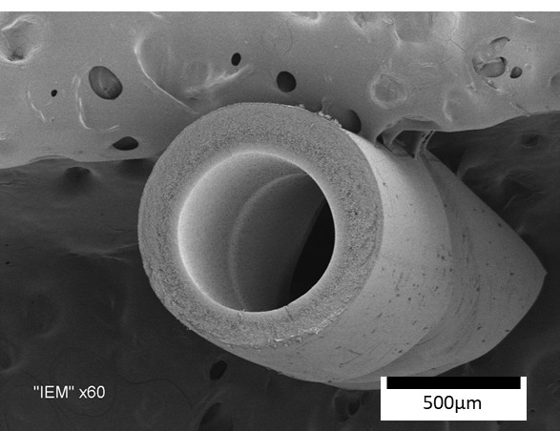

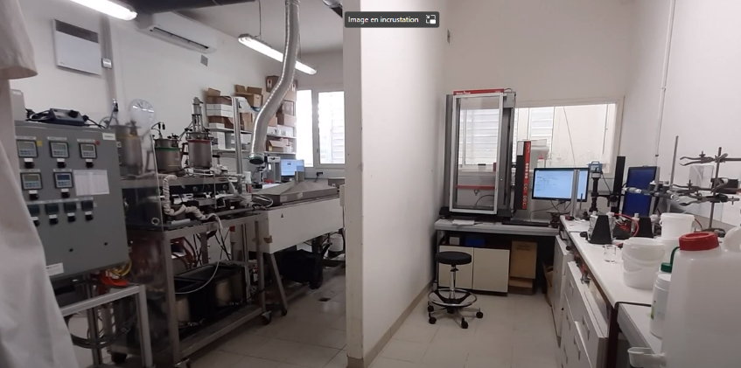
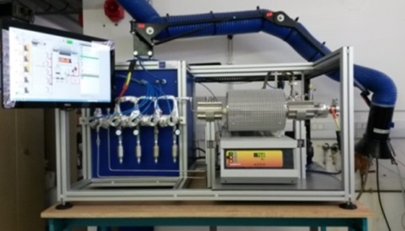
Pilot Line #8 – Surface modification of polymeric hollow fibers by co-co-extrusion or Atomic layer Deposition (ALD)
Joint development between University of Montpellier and Polymem company
Spinning capacity:
ALD capacity:
Collodion: 0.5-2.5 kg
Spinning speed: 0-20 m/min
Min. Internal ∅: 0.5 mm, Min. External ∅: 0.9 mm
Max batch duration : 6 H
25 hollow fibers 50 cm/batch
Batch duration: 35 min
TiO₂ deposition
Hollow fiber spinning line
ALD reactor

Slide 16
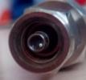
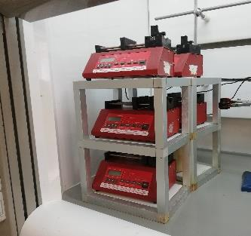
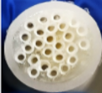
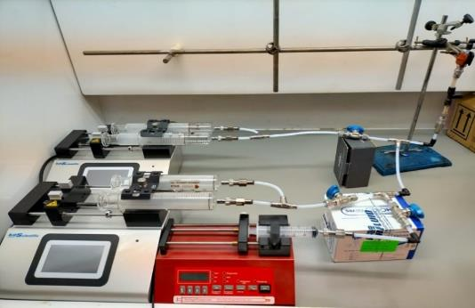

PL#9 - Modifications of Hollow Fibres by microfluidics
Interfacial polymerization (IP) coated hollow fibers (HF) for liquid and gas applications
  Microfluidic technology: from 1 to 25 hollow fibers
  Nanofiltration: reproducible performance with molecular solute rejections >95%
1 HF (ca. L= 10-15 cm)
25 HF (ca. L= 52 cm)
Upscaling/upgrading
16

Slide 17
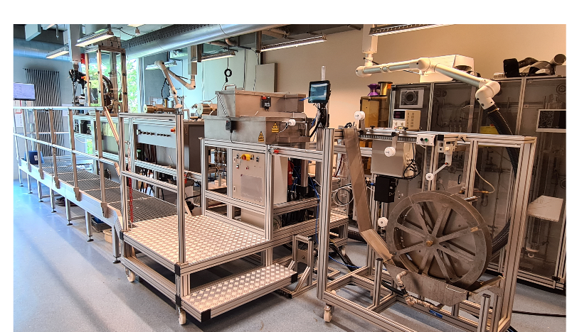
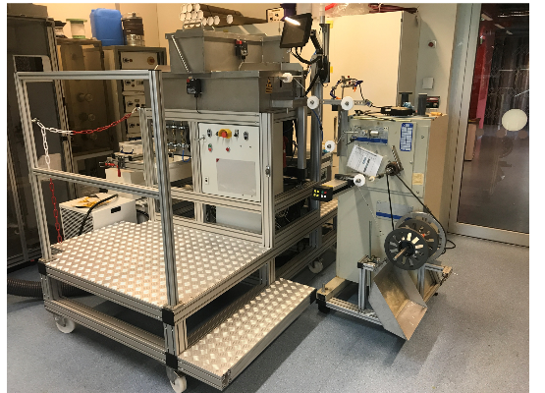

PL#10 - In-line modification of nano-coatings on hollow fiber membranes
Up-scale:
In-line nanoscale surface modification technology such as E-beam to crosslink a nano-sized selective coating.
Aim is to develop a next generation membrane with in-line surface modification, so the process will be more efficient, stable and less time-consuming. Treatment by E-beam can improve the stability of the membranes and potentially enhance the selectivity of the separation layer(s).
Up-grade:
Upgrade hollow fiber spinning line with an integrated, in-line, surface modification unit by means of electro-beam.

Slide 18
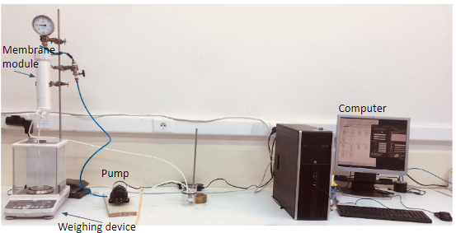
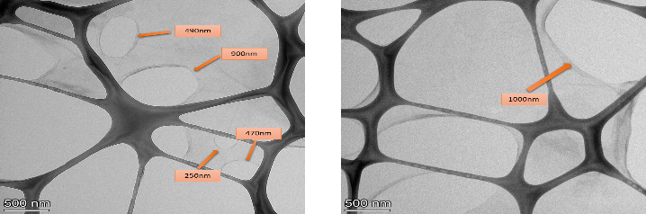

PL#11 - “Eco-friendly manufacturing of oriented GO (or CNTs) Layer by Layer (LBL) deposition membranes”
Pilot unit for the fabrication of Hollow Fiber membranes by Layer by Layer (LbL) assembly of oriented PEI (polyethylenimine)–functionalized Graphene Oxides (GOs). The holey GOs are produced by a cost- effective and eco-friendly electrochemical graphite exfoliation method followed by H₂O₂ treatment. Pilot Line #11 is linked to Showcase #7.

Slide 19
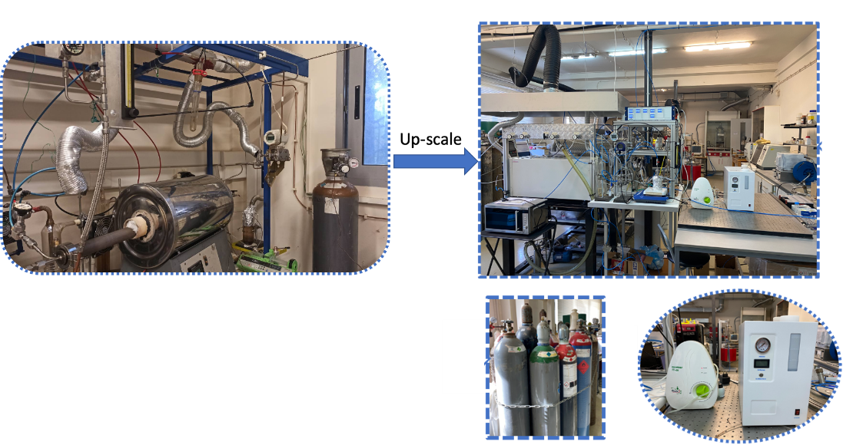
PL#12 - Up-scaled CVD/ALD deposition unit for the tailoring of the nanopore size of ceramic and stainless steel Molecular Sieving membranes
Fabrication of 0.5 meters long MS nanoporous ceramic and CNT membranes system using in-line gas-permeation monitoring of the nanopore size evolution, combined with and the deployment of in-situ differential permeability and gas relative permeability measurements.
Partners: Demokritos, SUK,HTF

Slide 20
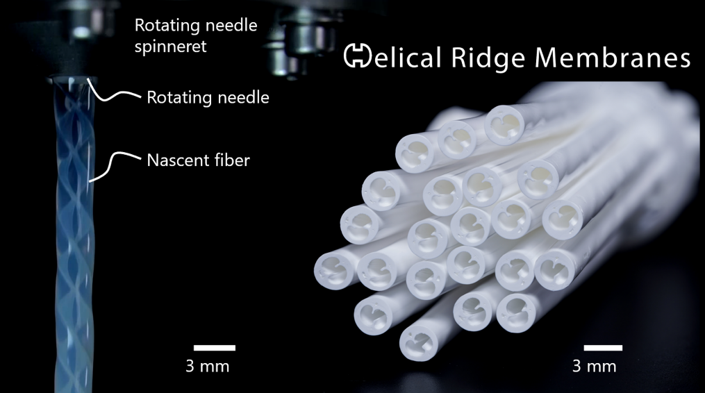

PL#13 - Hollow fiber membrane spinning with improved geometric features
Up-scale:
fabricating hollow fiber membranes with novel geometries, which enhance the transport properties of fluids within the membrane and help overcome mass transport limitations.
Up-grade:
Up-grading of the washing bath by a length-factor of 10
Addition of heating function of the bath up to 80°C
Spinneret fabrication shifted from polymeric 3D printing to metallic 3D

Slide 21
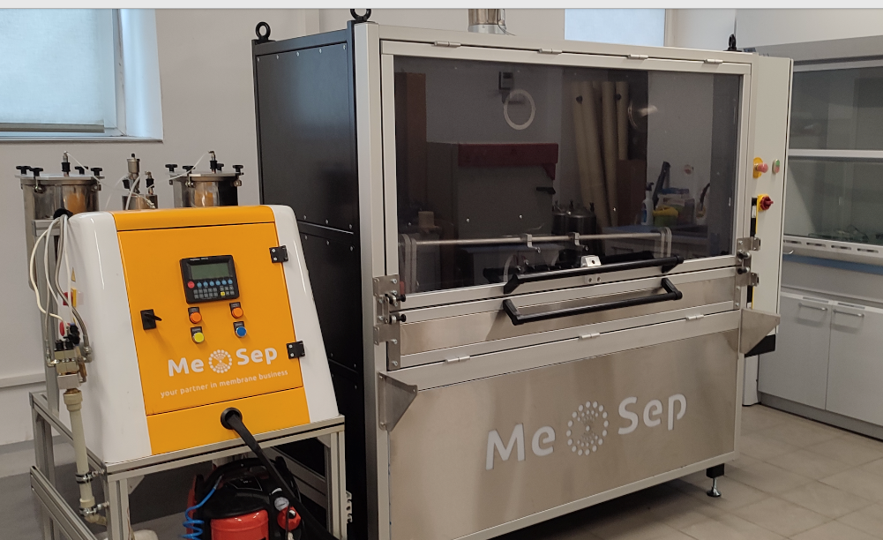
PL#14 - Centrifugal potting of HF membranes
Me-Sep upscaled and upgraded the system for centrifugal potting of hollow fiber membranes.
Current installation consist of resin dosing system, centrifuge capable accommodate 1 m x 6 inch HF modules and automated guillotine to open these modules at the end of production phase.

Slide 22
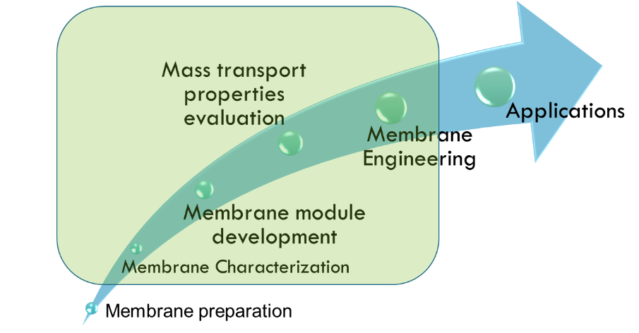
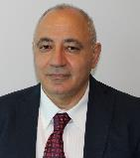
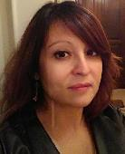



VIRTUAL LAB - TESTING AND CHARACTERIZATION
The Virtual Testing and Characterization Lab gathers facilities and apparatus for full characterization and testing of membrane materials, membranes and membrane operations (membrane reactors, gas separation, membrane distillation, pervaporation, micro/ultra/nanofiltration, solvent filtration, electrodialysis, etc.) passing from morphological/structural characterization to mass transport properties evaluation, long-term tests, pilot applications.
The VIRTUAL lab is located at partners’ premises and spread in various EU Countries. CNR-ITM coordinates and harmonizes the activities of the various partners, defining set procedures for testing and characterizing the membranes. For more details please contact our designated team below.
Contact details
Giuseppe BARBIERI
g.barbieri@itm.cnr.it
Responsible of Lab and Principal Investigator
Research Director at Institute on Membrane Technology - National Research Council (CNR-ITM), Rende CS, ITALY
Adele BRUNETTI
a.brunetti@itm.cnr.it
Dissemination Manager and Principal Investigator
Researcher at Institute on Membrane Technology - National Research Council (CNR-ITM), Rende CS, ITALY

Slide 23

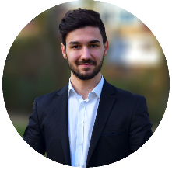

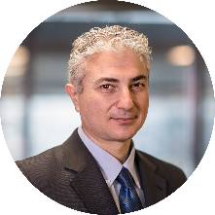

VIRTUAL LAB - MODELLING
The virtual lab contains a collection of mathematical models for a range of membrane and membrane reactor applications provided by partners within the INNOMEM consortium. This tool serves to manage and assign your modelling requests according to defined heuristics in order to connect you with the most appropriate modelling partner. This virtual lab offers a real multi-scale approach to the modelling problem, starting from ab-initio calculations to full scale process design. For use of this tool and any modelling request you might have, please contact our designated team below.
Contact details
Zançat Sahin
z.e.sahin@tue.nl
Virtual Lab Manager
Doctoral researcher,
Eindhoven University of Technology
Fausto Gallucci
f.gallucci@tue.nl
Project Technical Coordinator (PTC)
Professor and Dean of Dpt. of Chemical Engineering and Chemistry, Eindhoven University of Technology

Slide 24
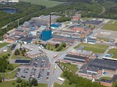
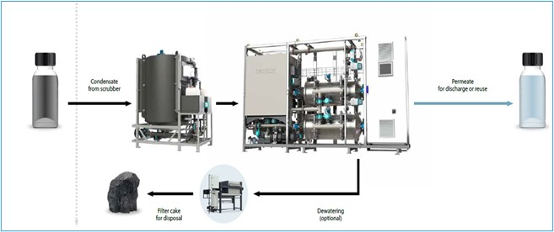

SC#1: Grafted ceramic membranes for wastewater purification
Validation PL#3
Description: Process intensification of metal removal from wet scrubber wastewaters from power plants by grafted ceramic membranes.
Functionalities targeted: Anti-fouling effect of grafted SiC membranes leading to higher flux and retention, and thus lower CAPEX and OPEX.

Slide 25
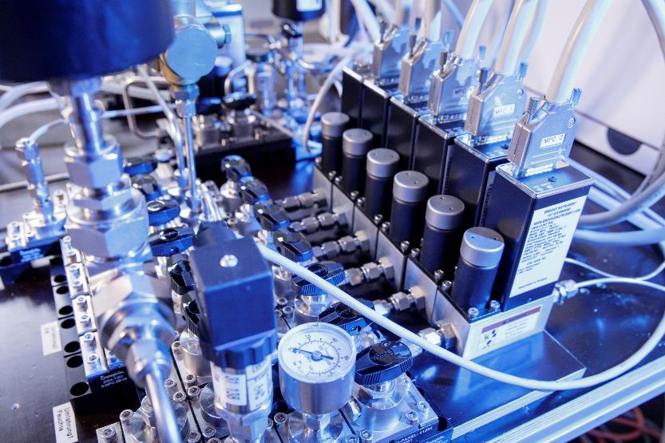
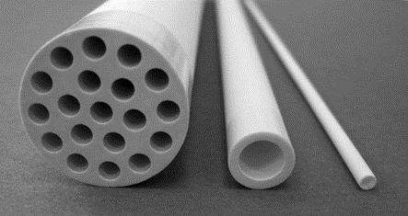
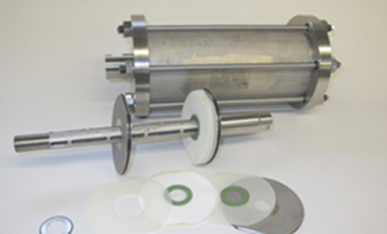


SC# 2 - Zeolite and polymeric membranes in natural gas treatment
Linked to PL # 5 (Helmholtz Zentrum Hereon) &
PL # 6 (Fraunhofer IKTS)
CO2 and n-butane separation from natural gas / CH4
  Flat sheet polymeric membranes (PL # 5)
    TFCM: CO2 / CH4
    POMS: n-butane / CH4
  Ceramic membranes (PL # 6)
    CHA-membranes: CO2 / CH4
    MFI-membranes: n-butane / CH4
25

Slide 26


SC#3 – Mixed Matrix Membranes for liquid and gas separation
Validation PL#1, 8, 9, 14
Description: MMMs for natural gas and biogas upgrading and for water treatment.
Functionalities targeted:
  In case of natural gas: high selectivity (e.g. CO₂/CH₄ > 50) and high permeance.
  In case of NF: high rejection to small molecules (i.e. 200-300 Da) and high water flux.
  MMMs for water treatment by microfiltration (MF), ultrafiltration (UF) and nanofiltration (NF
Notes:
Please double check if Imperial college and Aston belong to this SC

Slide 27
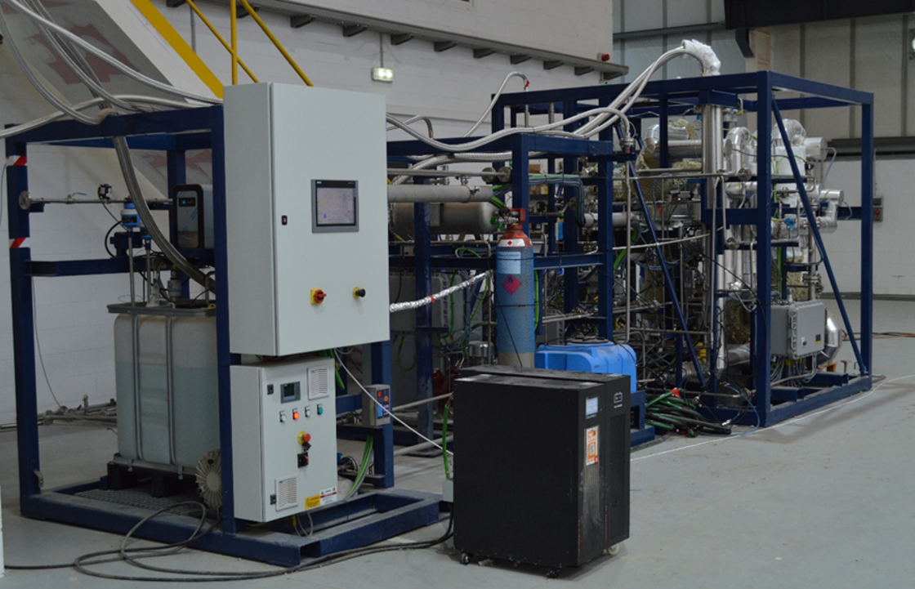




SC#4 – Advanced membranes for pure hydrogen production/purification
Validation PL#2
Description: Ultrathin Pd-based membranes produced by electroless to obtain pure hydrogen
Functionalities targeted: Tubular with high flux and high selectivity

Slide 28
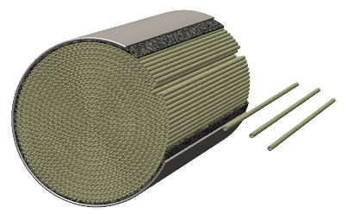
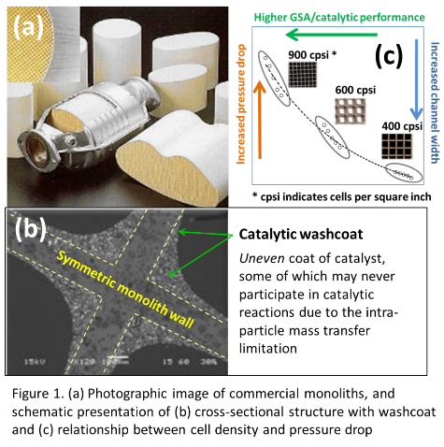

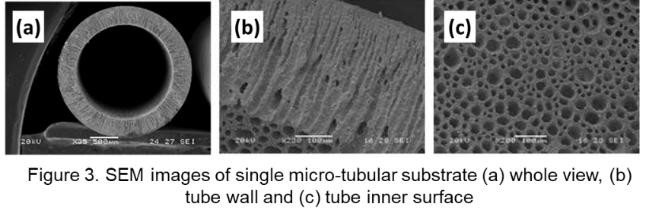

SC#5 – Micro-tubular and micro-monolith ceramic membranes
Develop innovative ceramic membrane substrate for the next generation of catalytic converter
  Own the plurality feature of micro-voids or micro-channels inside channel walls
  Enable 7 to 8-fold increase in geometric surface area compared to cordierite monolith, together with high open front area
  Improved flow dynamics: reduced pressure drop and improved gas-catalyst contact
  Significantly reduce the amount and costs of precious group metals (PGM) catalyst
Work closely with PL4 to scale-up the production line for continuous large-scale production.

Slide 29

SC#6 - Functionalized polymeric HF membranes for aqueous applications
Validation PL#10
Description: Production of HFs with additional in-line coating and/or crosslinking
Functionalities targeted: Enhanced stability and selectivity
Notes:
Add picture

Slide 30
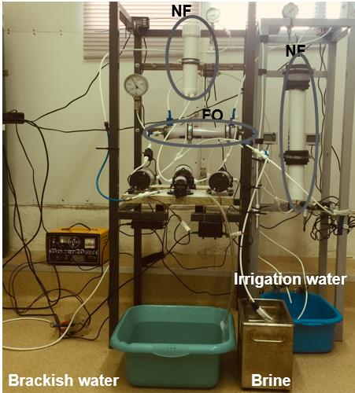

SC#7 – Cost-effective NF/FO Irrigation System
Validation PL#11
Development of low energy demand desalination pilot unit for brackish water to produce low cost, low salinity irrigation and fertigation water streams.
Achievement of a nearly zero liquid discharge symbiotic operation (ZLD).

Slide 31
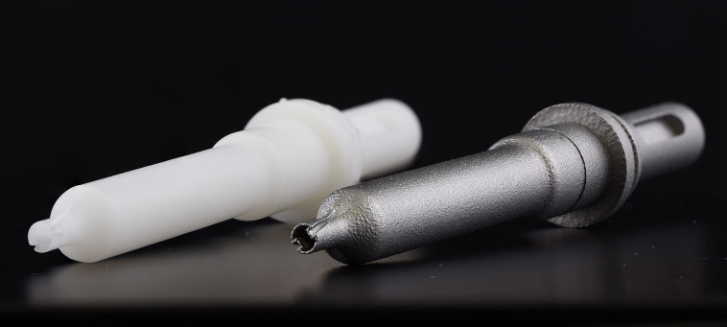
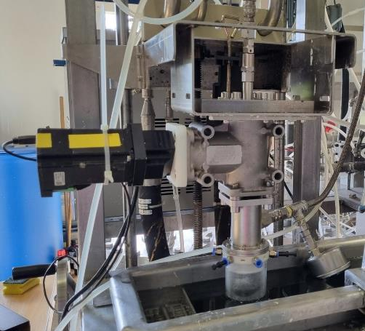
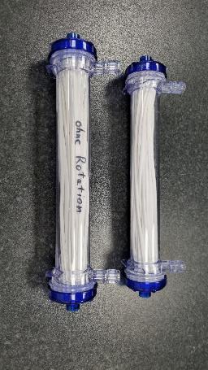

SC#8 – Polymeric HF membranes with for ultra- and microfiltration
Validation PL#13
Description: Production of HF membranes with advanced geometric features for ultrafiltration
Functionalities targeted: Enhanced fouling performance
Fabrication of custom metal 3D printed spinnerets for its implementation in FILATECH
*Pilot line and membranes produced at FILATECH

Slide 32


SC#9 – Anion-Conducting Membranes for Energy Applications
Description: Anion-conducting membranes to be used in alkaline water electrolysis to produce H₂
Validation of PL#7
Showing feasibility of SEP by transferring lab scale synthesis to pilot line fabrication
Development of production parameter
Advanced in-depth characterization of membrane nanostructure and properties
Notes:
Add picture

Slide 33
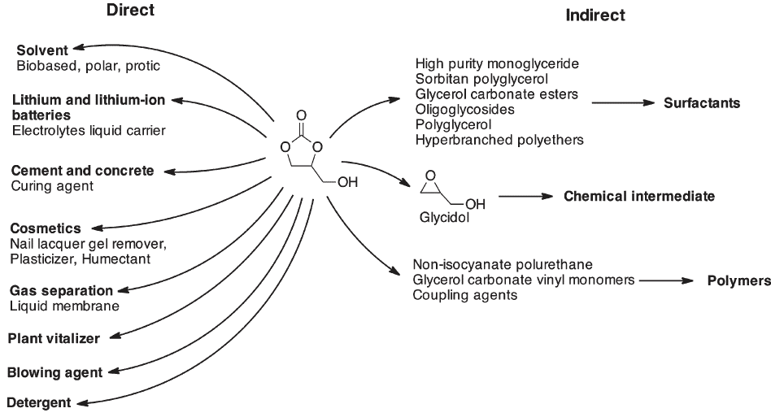
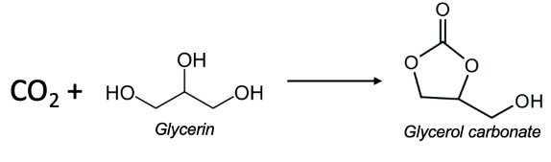

SC#10 – Development of molecular sieving membrane intensified processes
Validation PL#12
Description: Remove water to shift the equilibrium to produce high added value glycerine carbonate from CO₂ and glycerol, a low-cost by-product of the biodiesel synthesis.
Notes:
Add picture

Slide 34
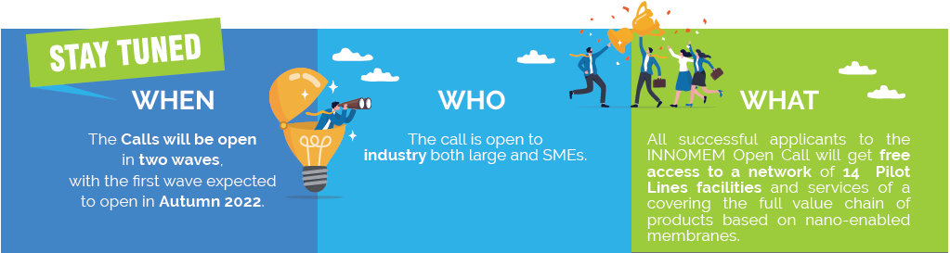
THE OPEN CALLS
INNOMEM aims at developing a sustainable OITB (Open Innovation Test Bed) to foster deployment and scale-up of innovative nano-enabled membranes and their derived products.
The INNOMEM test bed will demonstrate how innovative nanomembranes can be used to address real life industrial problems, opening the market for these new products. INNOMEM will offer its network of facilities and services through a Single-Entry Point (SEP).

Slide 35
THE OITB SERVICES CATALOGUE
The selected applicants will be provided with customized support through a complete set of services integrating technical and business expertise which will enable them to build up sustainable business cases.
TECHNICAL SERVICES
Membrane properties characterisation techniques
Membrane scale up (equipment and techniques)
Development and scale up of membranes
Process design, modelling and simulation
NON-TECHNICAL SERVICES
Data management
Software development
Venturing activities
Techno-economic analysis and market validation
Consultancy
Innovation services

Slide 36
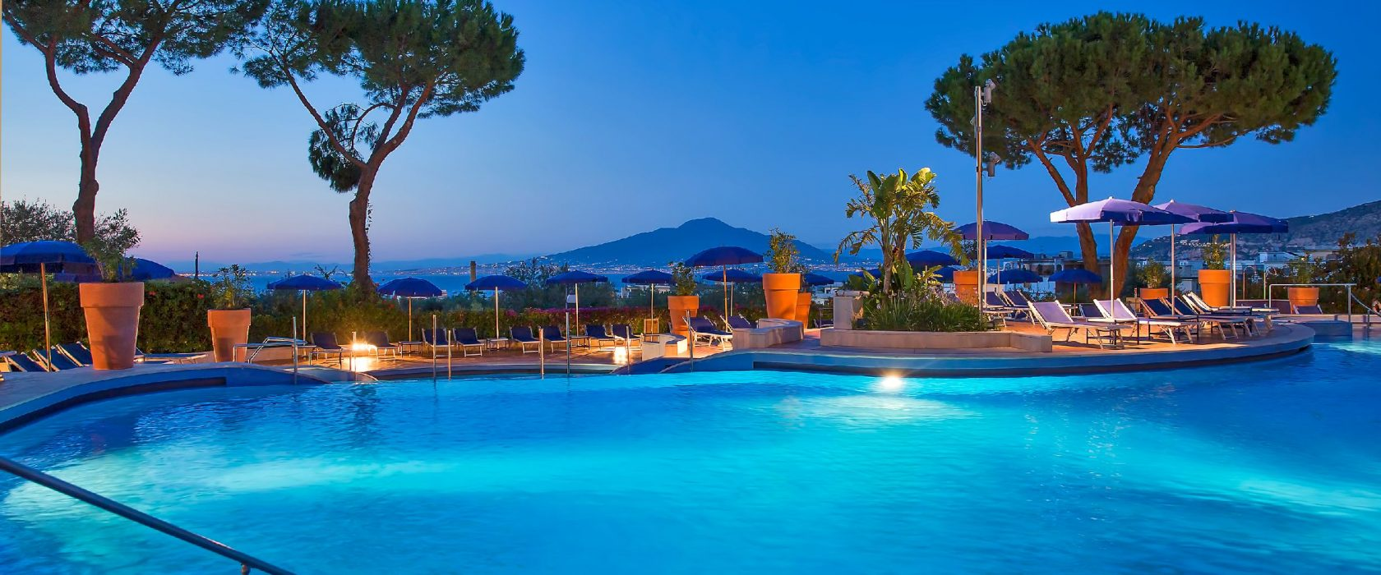

FIRST WORKSHOP
17-18 November 2022
Sorrento (Naples, Italy)
https://www.innomem.eu/

Slide 37

Partners
37
Notes:
Quality of logos very poor, it should be updated.

Slide 38

Thank you
38

